Slide 1


Will they claim it?
Greyatom Hackathon
by Wanderlust Data

Slide 2

Business Objective
Problem Overview
Our objective is to help the underwriting team to predict whether a new buyer will make the claim or not:
For an insurance company, the forecasting of claims is central to a successful operation. If the claims can be forecasted accurately, premiums can be adjusted accordingly, creating the opportunity to be one step ahead of the competitors. Charging a lower premium than the competitors, while maintaining a sufficient buffer to make profit to stay in business, will lead to more customers, which in turn leads to more profit.
This will eventually help the underwriter determine the premium for the buyer and the extent of coverage for the buyer.
It will also help the underwriter devise new travel insurance products that would help get more customers on board.

Slide 3

What does an Insurance Underwriter do?
Who are the Stakeholders? Who will benefit from the findings?
An insurance underwriter reviews and evaluates:
▪ The level of risk you pose
▪ Your premiums
▪ The extent of coverage for which you are eligible
Head of Marketing Department
Calculate the appropriate premiums for the amount of coverage requested
Head of Finance Department
On-board more customers with low risk
profile.
Head of Claims Department
Processing Department
If an underwriter is too conservative, an insurance company may lose business. If they are too generous, the company may need to pay excessive claims
Insurance Underwriter

Slide 4

Data Science
Problem
To predict if a new buyer will make the claim or not based on the given data.
Business Metric
To correctly identify high and low risk customers by looking at the claim pattern, such that we increase the customer onboarding rate by 25%
Data Science
Metric
Precision - We are trying to reduce the number of instances where we have predicted that a person will claim but he has not claimed
Assumptions
The target column is ‘Claimed or Not Claimed’ and not ‘Sanctioned or Not Sanctioned’
Our model is assumed to be an intermediary model

Slide 5

Exploratory
Data
Analysis

Slide 6
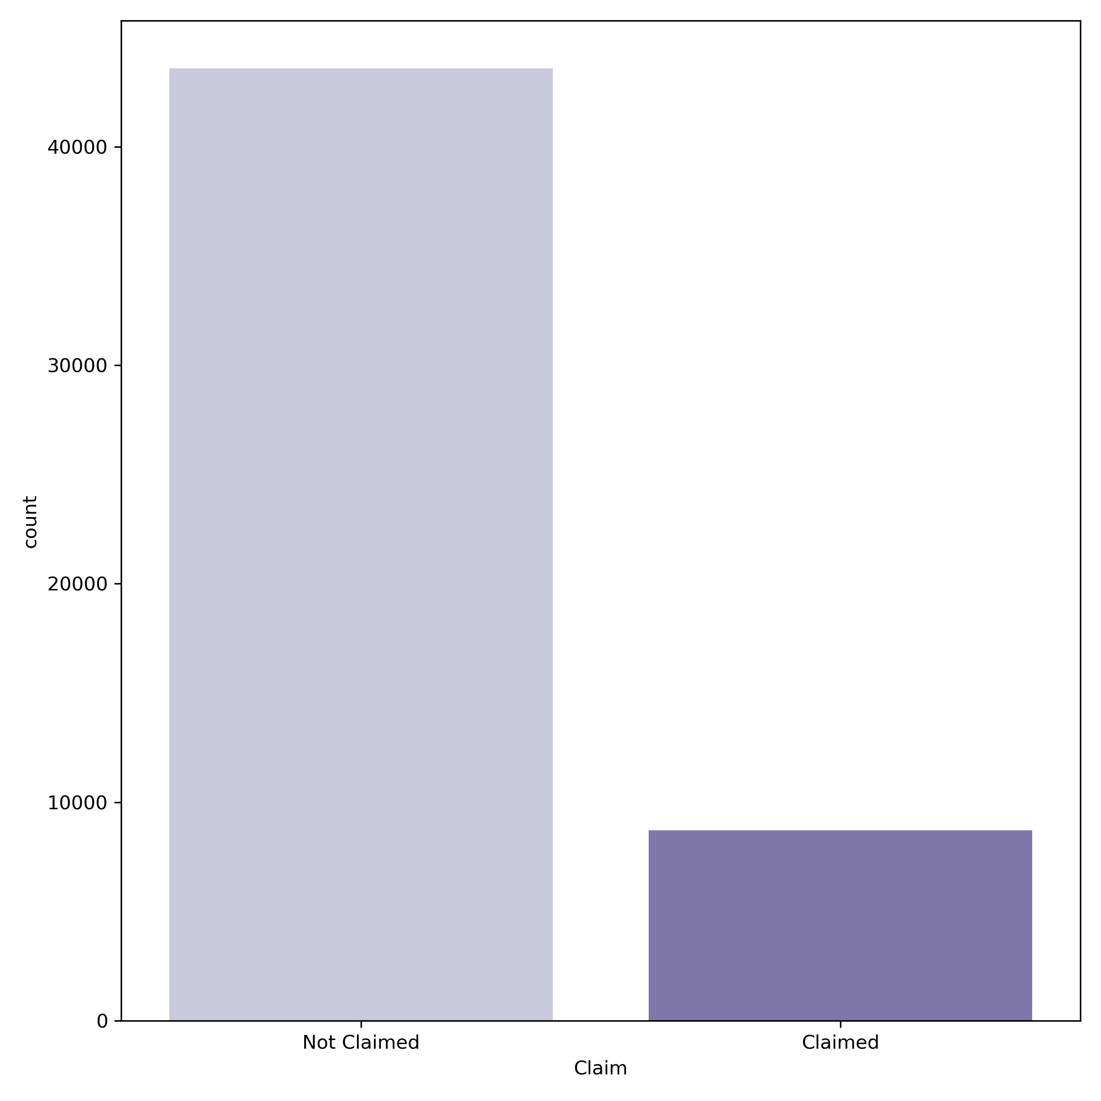

How many claims were made?
43590
Observation
Data is Imbalanced as the number of customers who have not made any claim is 5 times the number of customers who have made the claim.
Recommendation
To make payment of claims more affordable for the company, we need to pool low risk clients i.e. customers who have low probability of claiming in the future.
8720

Slide 7
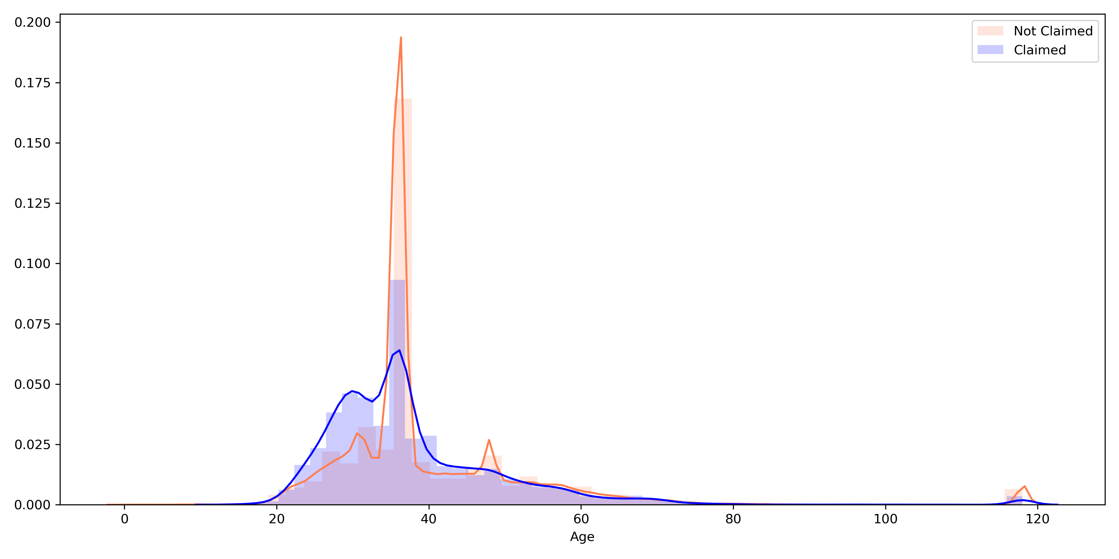
Does age effect the Claim likelihood?
Insight
Age group of 30-42 years tends to claim more.
Customers above the age of 70 years form 2.5% of customer base.
Assumption
2.5% of customers above the age group of 70 years could have bought Travel Medical Insurance for medical tourism.
Recommendation
As the age increases, the risk to the insurance company increases. We see that the claim ratio (11%) is low for the higher age group. However, to further reduce the risk we can cap the duration of insurance to 30 days from the current average duration of 46 days.
30
42
(Quartile 1)
(Quartile 3)

Slide 8
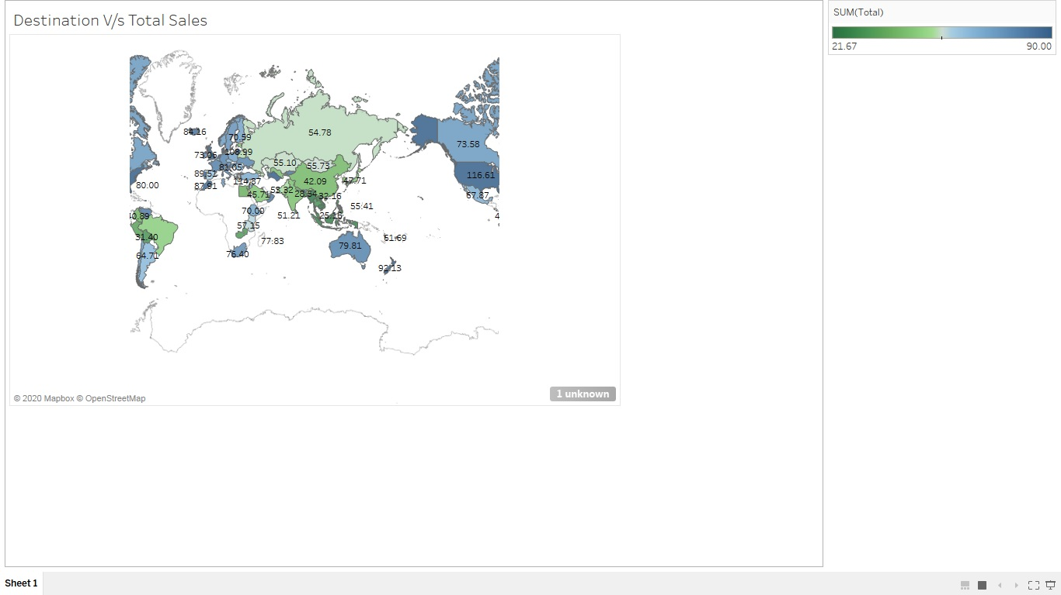

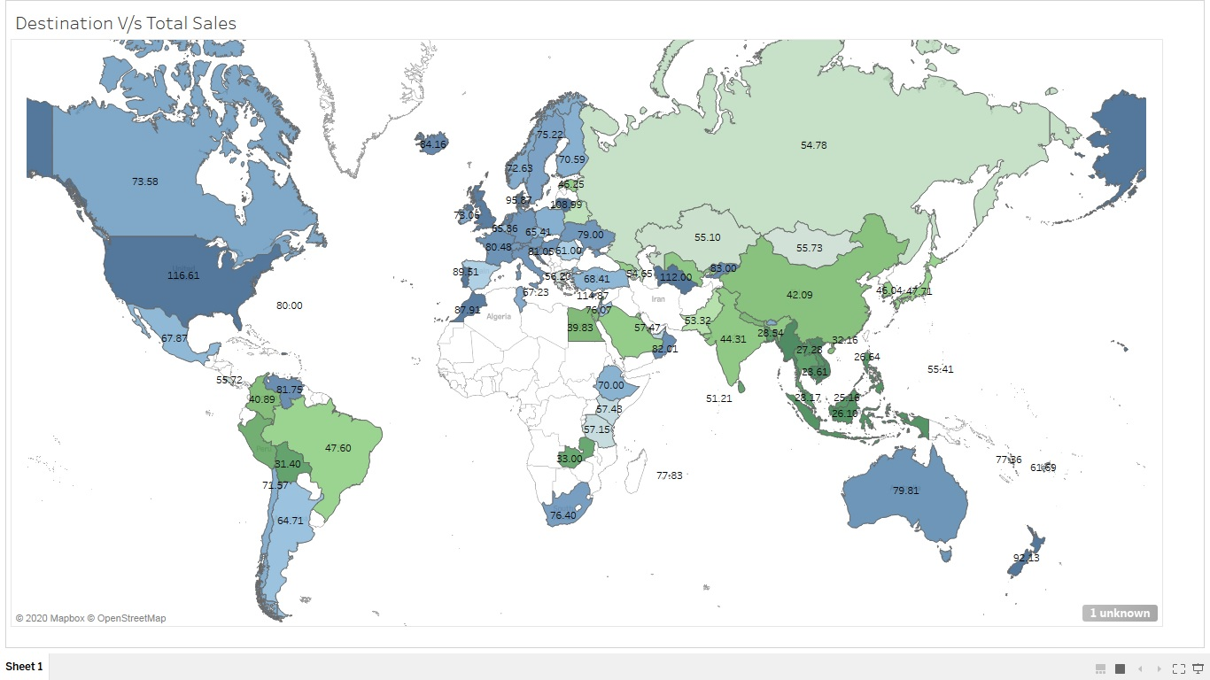

Average Total Sales
Average Total Sales by Destination
Denmark (95.9)
Lithuania (108.9)
USA (116.6)
Turkmenistan (112)
Cyprus (114.9)
Singapore(94.6)
*Total Sales = Net Sales + Commission

Slide 9
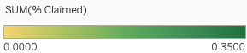
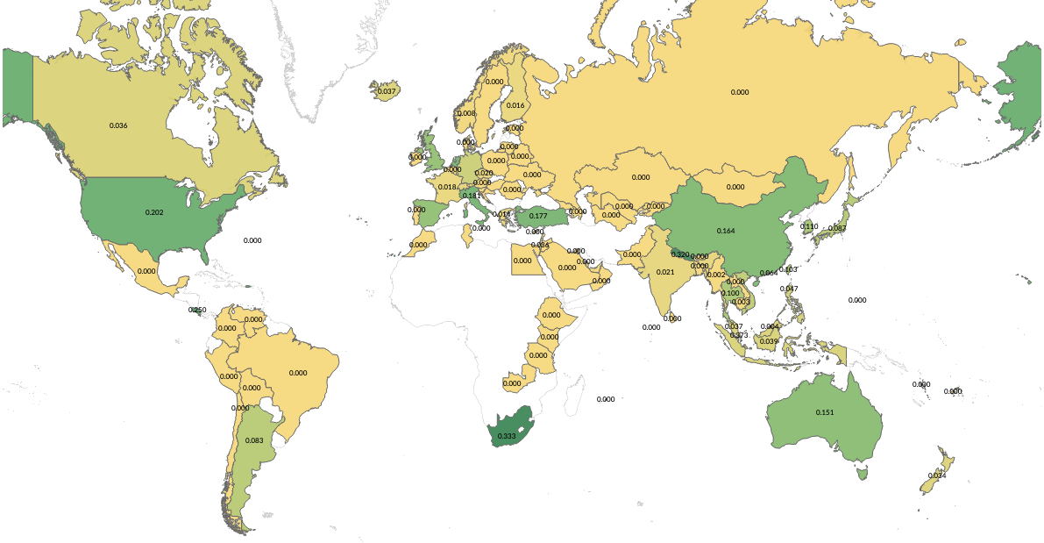
Claim Rates by Destination
Claim Rates
USA (20%)
Nepal (32%)
Singapore(37%)
Costa Rica (25%)
South Africa (33%)
High risk customers travelling to Singapore, South Africa and USA have majorly bought the insurance from online channel
We will be able to analyse the data if we know the source location and purpose of travel.

Slide 10
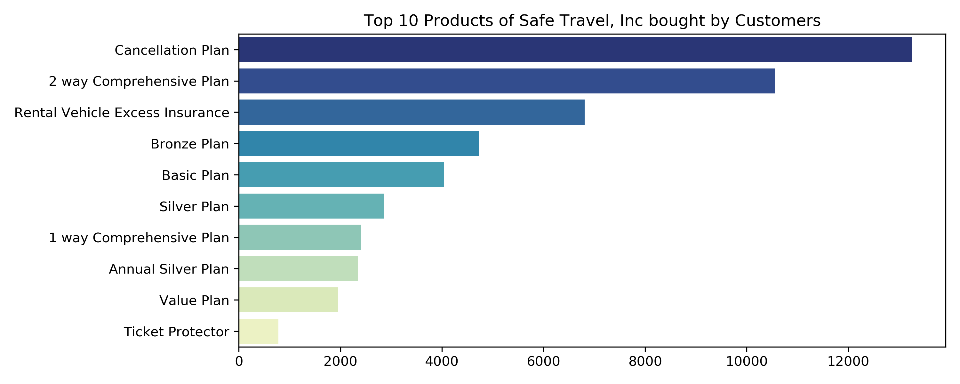
Which are the top 10 products of Safe Travel, Inc bought by the customer?
Observation
Cancellation Plan is the most preferred plan followed by 2 way Comprehensive plan and Rental Vehicle Excess Plan

Slide 11
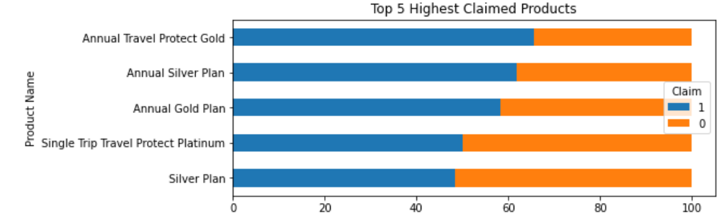
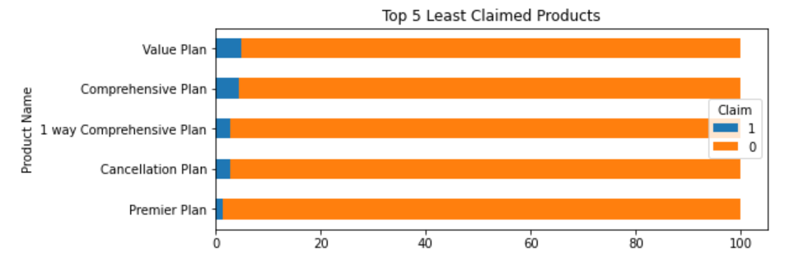
Which products have received highest and lowest claims?
Observation
Annual Travel Protect Gold, Annual Silver Plan and Annual Gold Plan have less buyers and highest claims.
The above plans have claims in the range of 48-66%
Observation
- Cancellation Plan, 1 Way Comprehensive Plan, Value Plan are amongst the top 10 most preferred products
- The above plans have claims in the range of 1.5-5%

Slide 12
What is their Claim Pattern?
Top Claimed Products
Least Claimed Products
Average Age of a customer who make Claims
37 years
45 years
Destinations most visited by people to make Claims
Singapore(94%)
Thailand(25%), USA(11%), China(10%)
Where did they buy Insurance from?
From Airlines (94%) through Online channel (100%)
From Airlines (91%) through Online channel (93%)
Avg. Net Sales and Commission charged
Net Sales: 167.53
Commission: 46.23
Net Sales: 33.08
Commission: 3.8
Median Duration of Travel
364 Days
28 Days

Slide 13

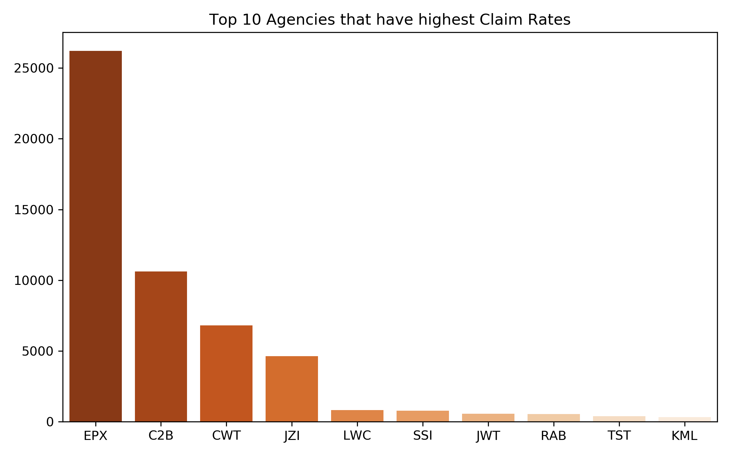
Which are the top agencies preferred by the customers of Safe Travel?

Slide 14
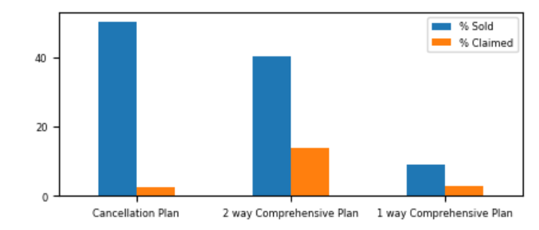

EPX |
Which are the products sold by them? What is their claim rate?
EPX is a Travel Agency which is into low risk products with the highest claim rate being 13.8% for 2 way comprehensive plan.
EPX is preferred for travel to China, Thailand and US amongst the higher age range.
1 way comprehensive plan preferred by the older age group.
Average Net Sales
28.59
53.95
33.97
Average Commission
0.28
0.19
0.64
Distribution Channel
Online(100%)
Online(98.6%)
Online(66.17%) Offline(34%)
Destination
Thailand (33%), US (11%), China (10%)
China (28%), US (17%), Thailand (12%)
China (29%), US (21%), Singapore (18%), Thailand (13%)
Average Age
34 years
37.5 years
62 years

Slide 15
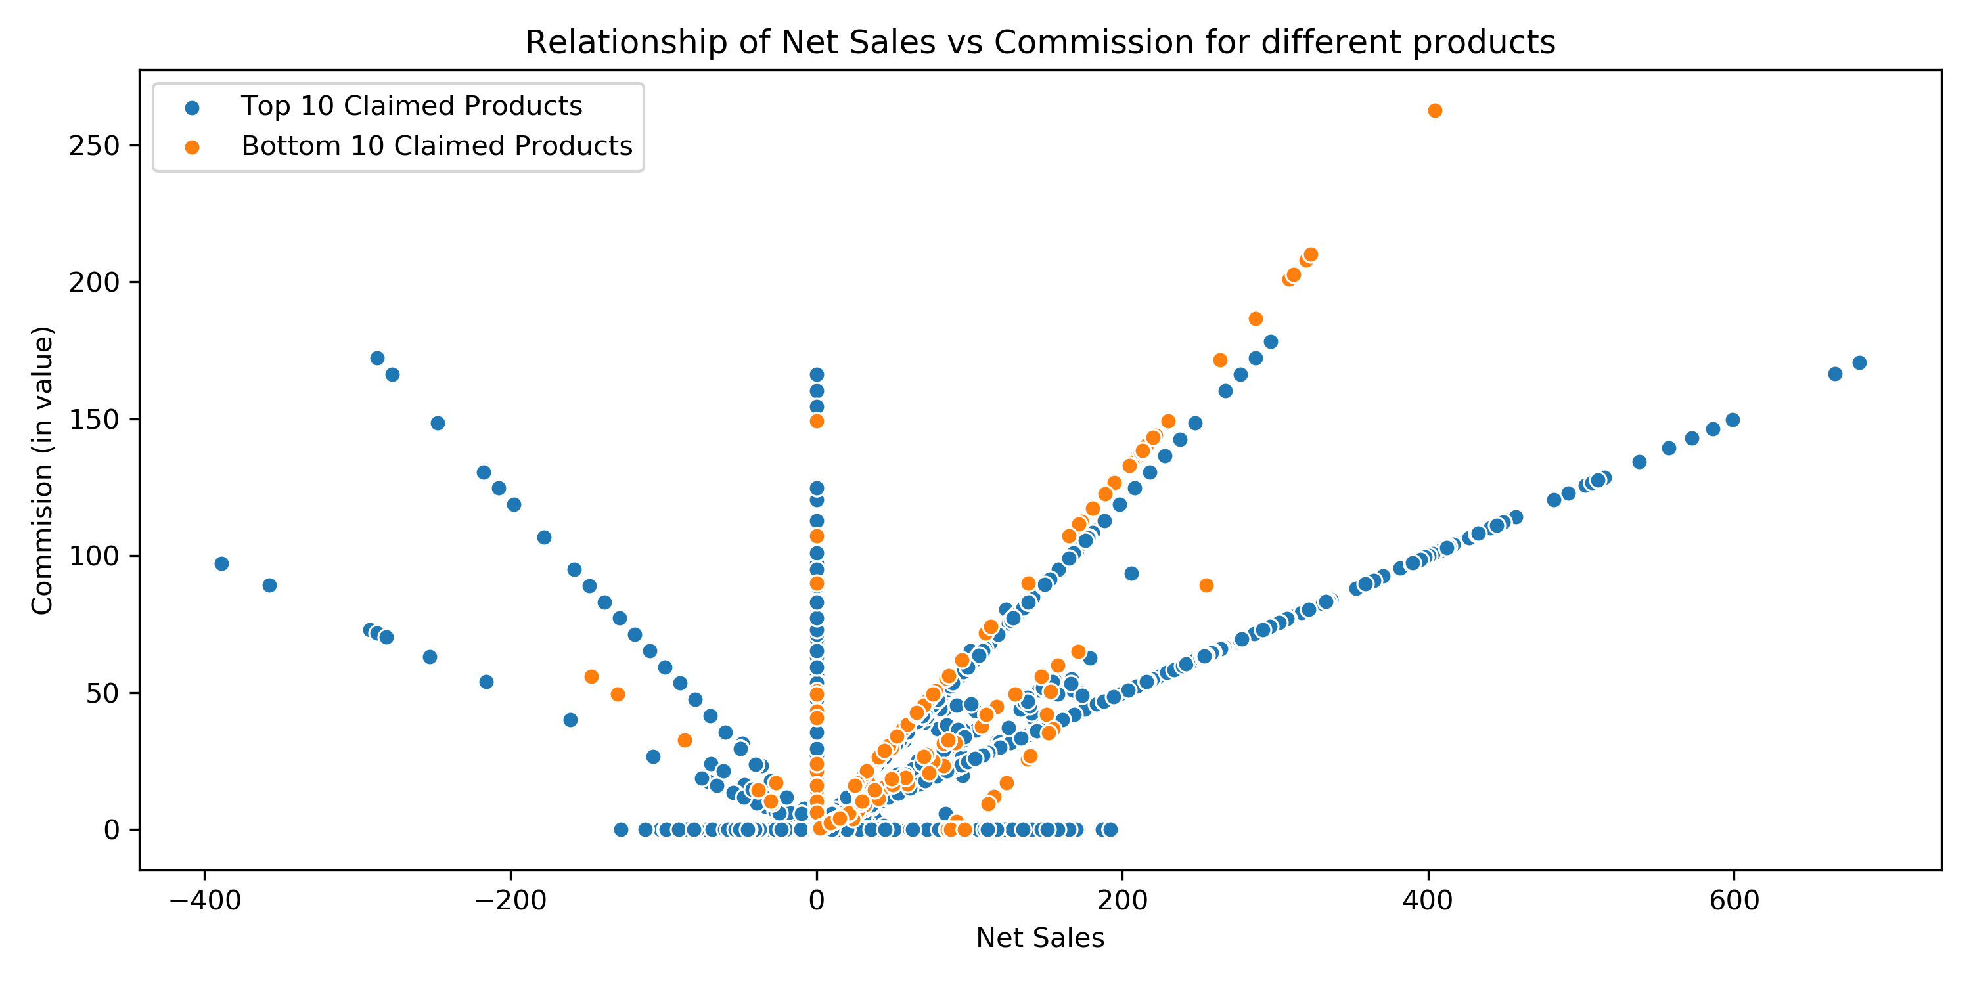
What’t the relationship between Net Sales and Commission?
Recommendation
High claimed products have high commission for high Net Sales and for products that were sold at a high negative sales. However, it has low commission for products that were sold at a low negative sales with majority of the policies being sold at 0 commission.
Low risk profile customers should be charged a low commission to ensure that we have more people buying our products.
Average commission for high claimed products is 12.26.
Insight
For products that have low claim rate, the net sales is in the range of -200 to 400 with the commission lying in the range of 0-50

Slide 16
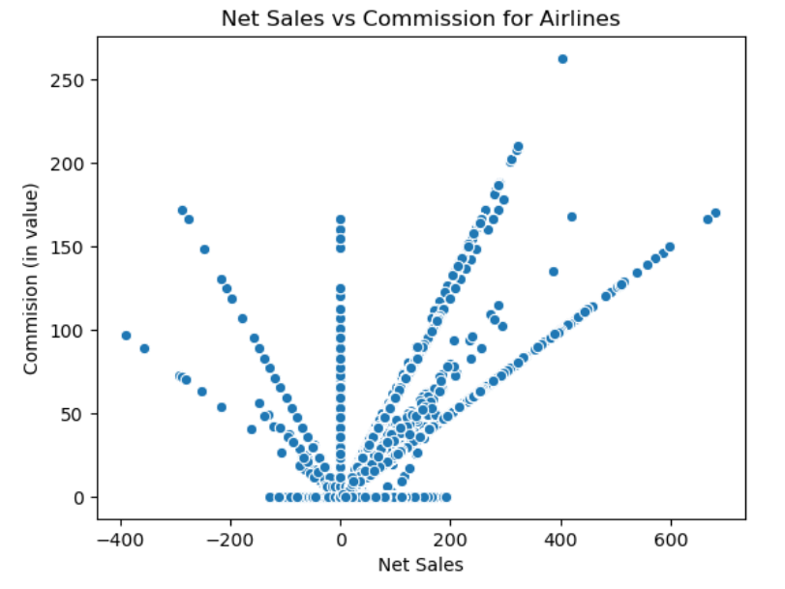
Are the negative values an error in data entry?
Observation
On first inspection, we observe that there is a symmetry between the positive and negative sales value when plotted against commission
Our Assumption: If there is no difference between commission charged for positive net sales value and negative net sales value, the negative net sales value are error in data entry and we can impute them with absolute values

Slide 17
Are the negative values an error in data entry?
Hypothesis
Null Hypothesis: There is no difference in the commission charged at Net Sales>0 and Net Sales<0
Alternate Hypothesis: There is a difference in the commission charged at Net Sales>0 and Net Sales<0
We conducted two-tailed t-test and found a p-value of 2.71

Slide 18
Are the negative values an error in data entry?
Conclusion
We rejected the Null Hypothesis - There is a significant difference in the commission charged at Net Sales>0 and Net Sales<0.
We also found that the average commission charged for negative sales was higher than at positive sales.
Negative sales could be a result of discounts/ promotional offers

Slide 19
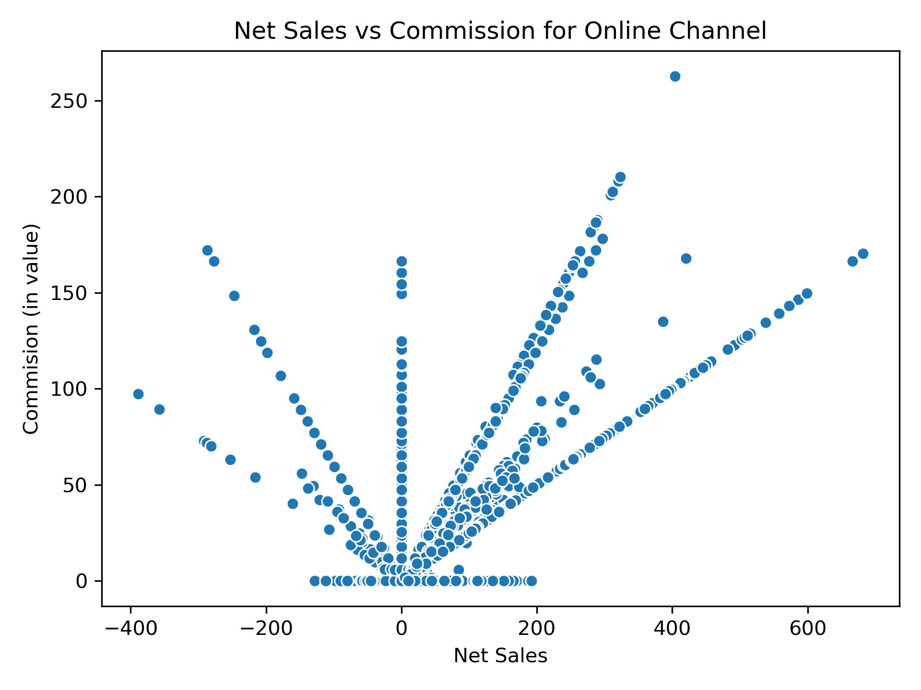
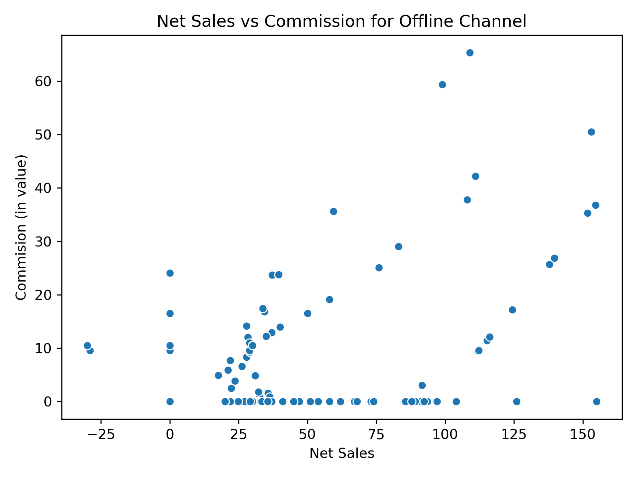
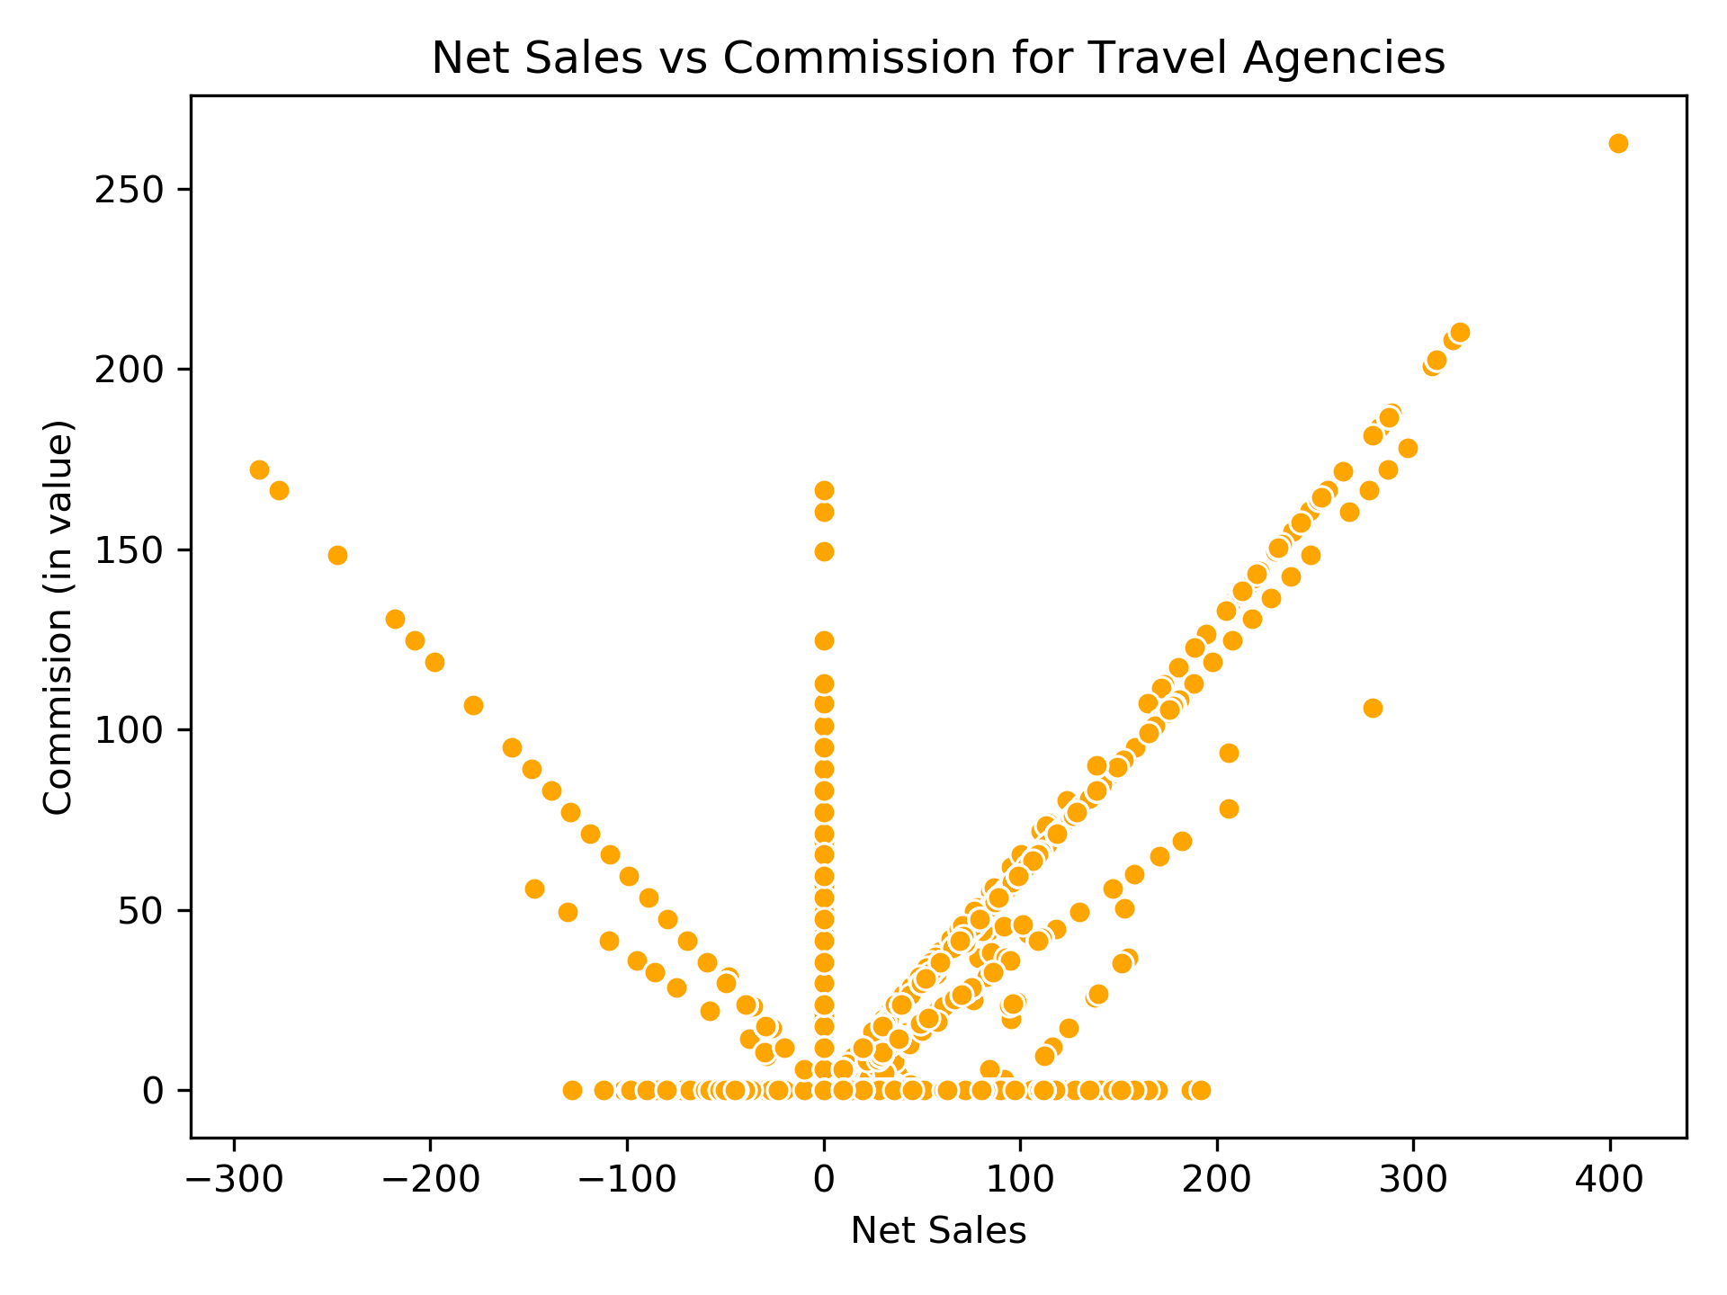
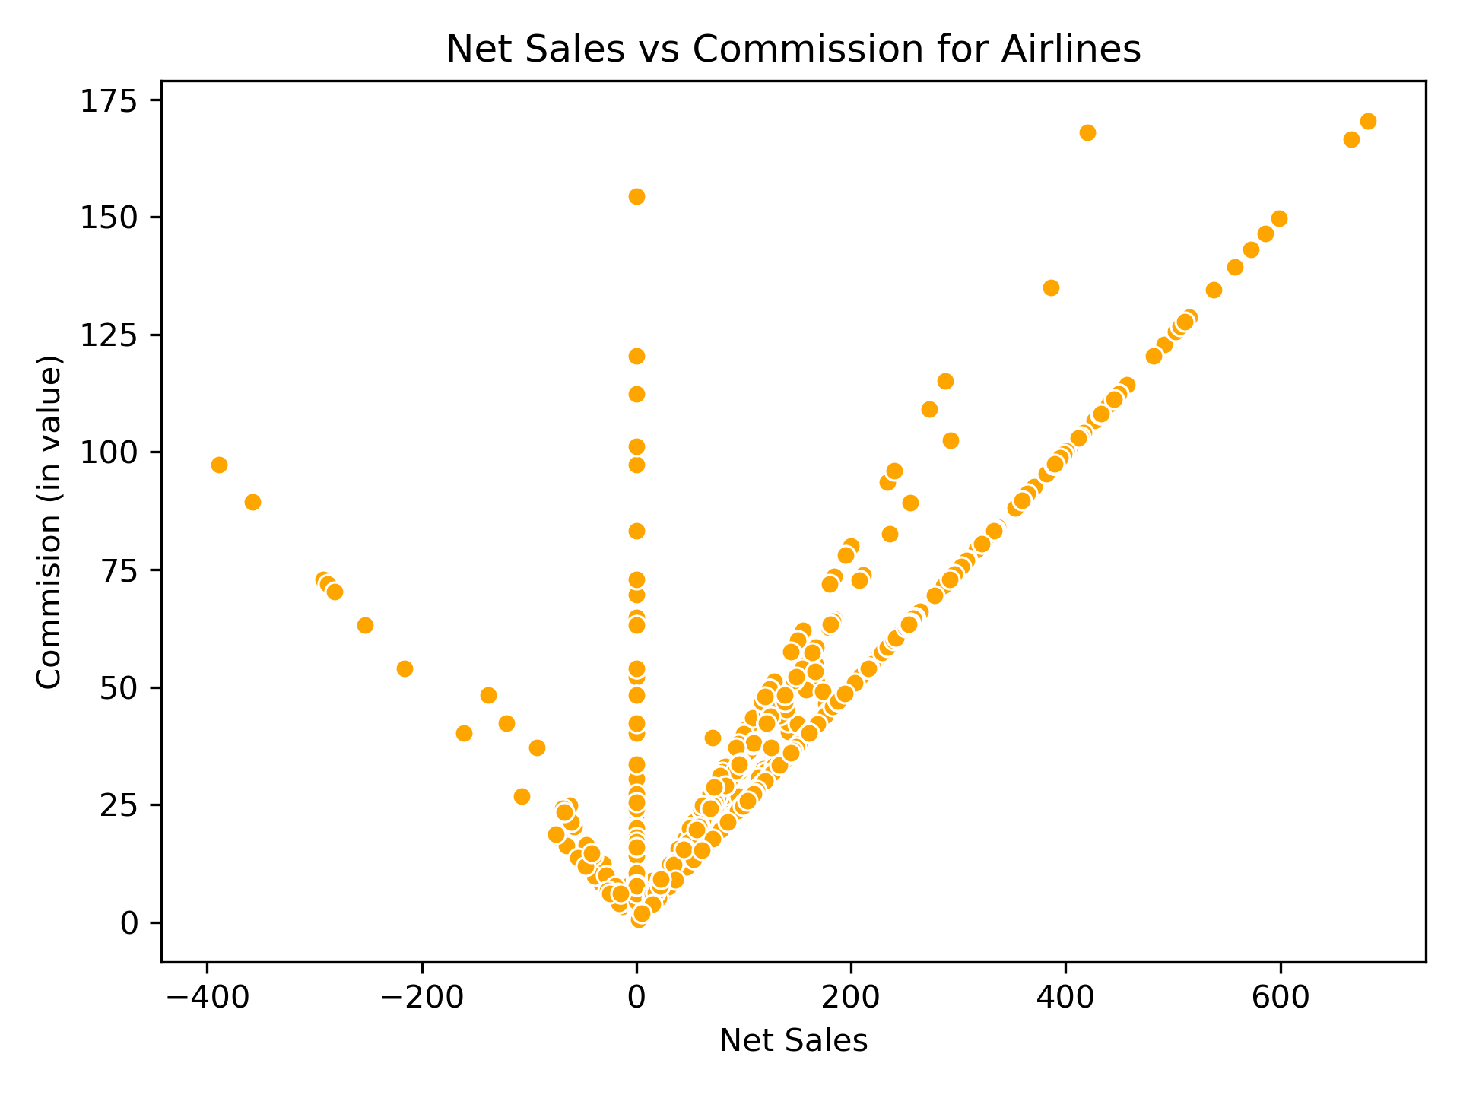
How does Distribution Channel and Travel Agency affect Sales and Commission?
Distribution Channel
Insight
We see that the policies sold online and through travel agency and airlines have negative net sales.
Since the negative net sales value is very high, we are assuming that online channel must have given heavy discounts (something like buy 1, get 1) to attract more customers.
Agency Type
We also observe that Airlines don't work with 0 commission; while the travel agencies do work with 0 commission.
Assumption: Some Travel Agencies also work as tour operators and could be including the commission in the tour package instead of charging it exclusively.
Insight

Slide 20

Model
Building

Slide 21

Model Building Stages
Pre-processing
Feature Engineering
Feature Selection
Baseline Model
Oversampling Techniques
Threshold Tuning

Slide 22
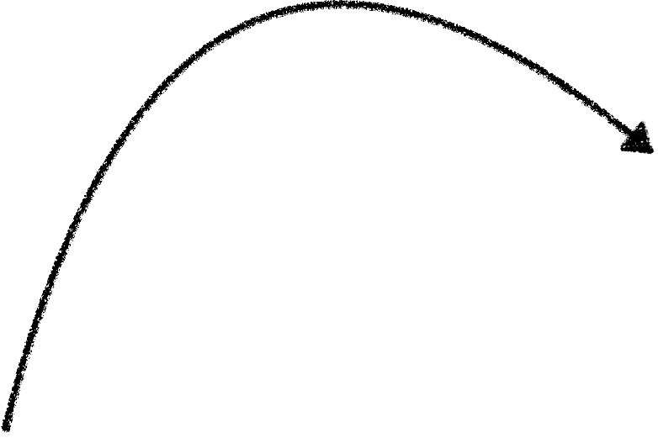
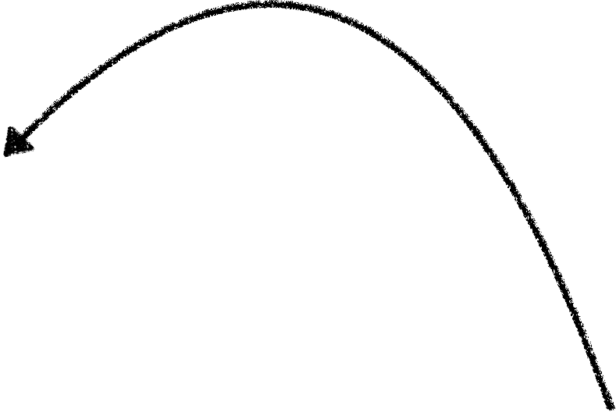
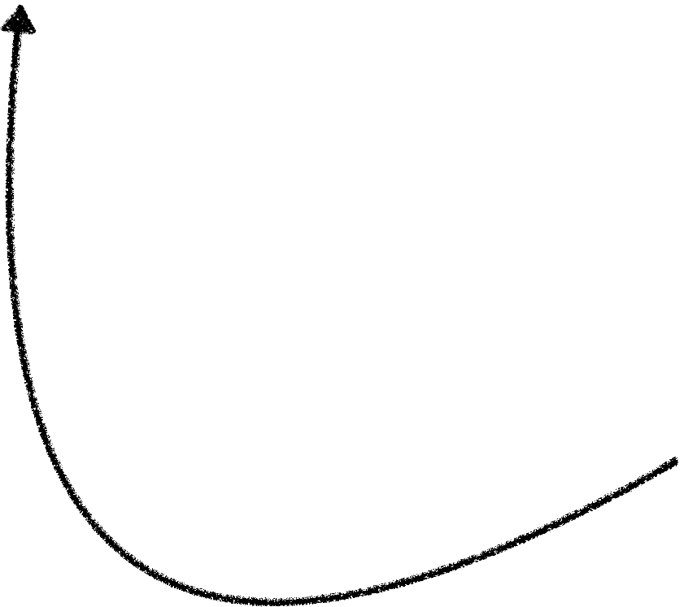
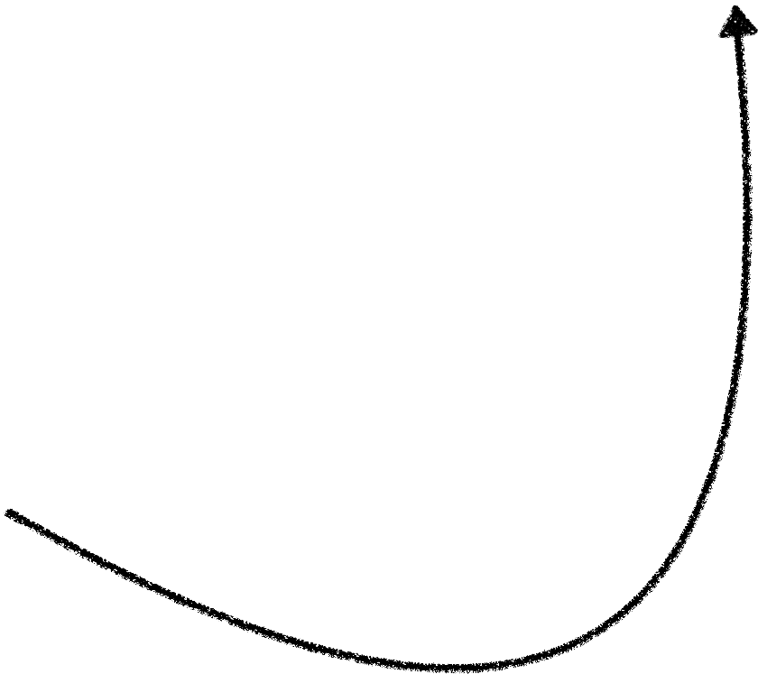
Approach
Pre-processing
Feature Engineering
Strategy 1
Feature Selection
Strategy 2
Baseline Model
Oversampling Techniques
Threshold Tuning

Slide 23


Strategy 1
Strategy 2
Duration Column: Replace -1, -2 by 0
Duration Column: Replace -1, -2 by 0
Pre-processing
OHE all categorical features, Sqrt. transformation of cont. features, Standard Scaler
What’s Different: OHE countries into top 10 and ‘Others’. OHE rest all categorical features
Feature Engineering
- Drop ID
- Drop ID, Combine Net Sales and Commission Features (SUM).
Feature Selection
Ensemble Models (RF highest performing)
Ensemble Models (RF highest performing)
Baseline Model
- Done. Random Over Sampler
- Done. Random Over Sampler
Oversampling Techniques
Threshold Tuning
Probability of predicting 1 fine-tuned to optimise presicion.
Probability of predicting 1 fine-tuned to optimise presicion.

Slide 24

Balancing
Data

Slide 25
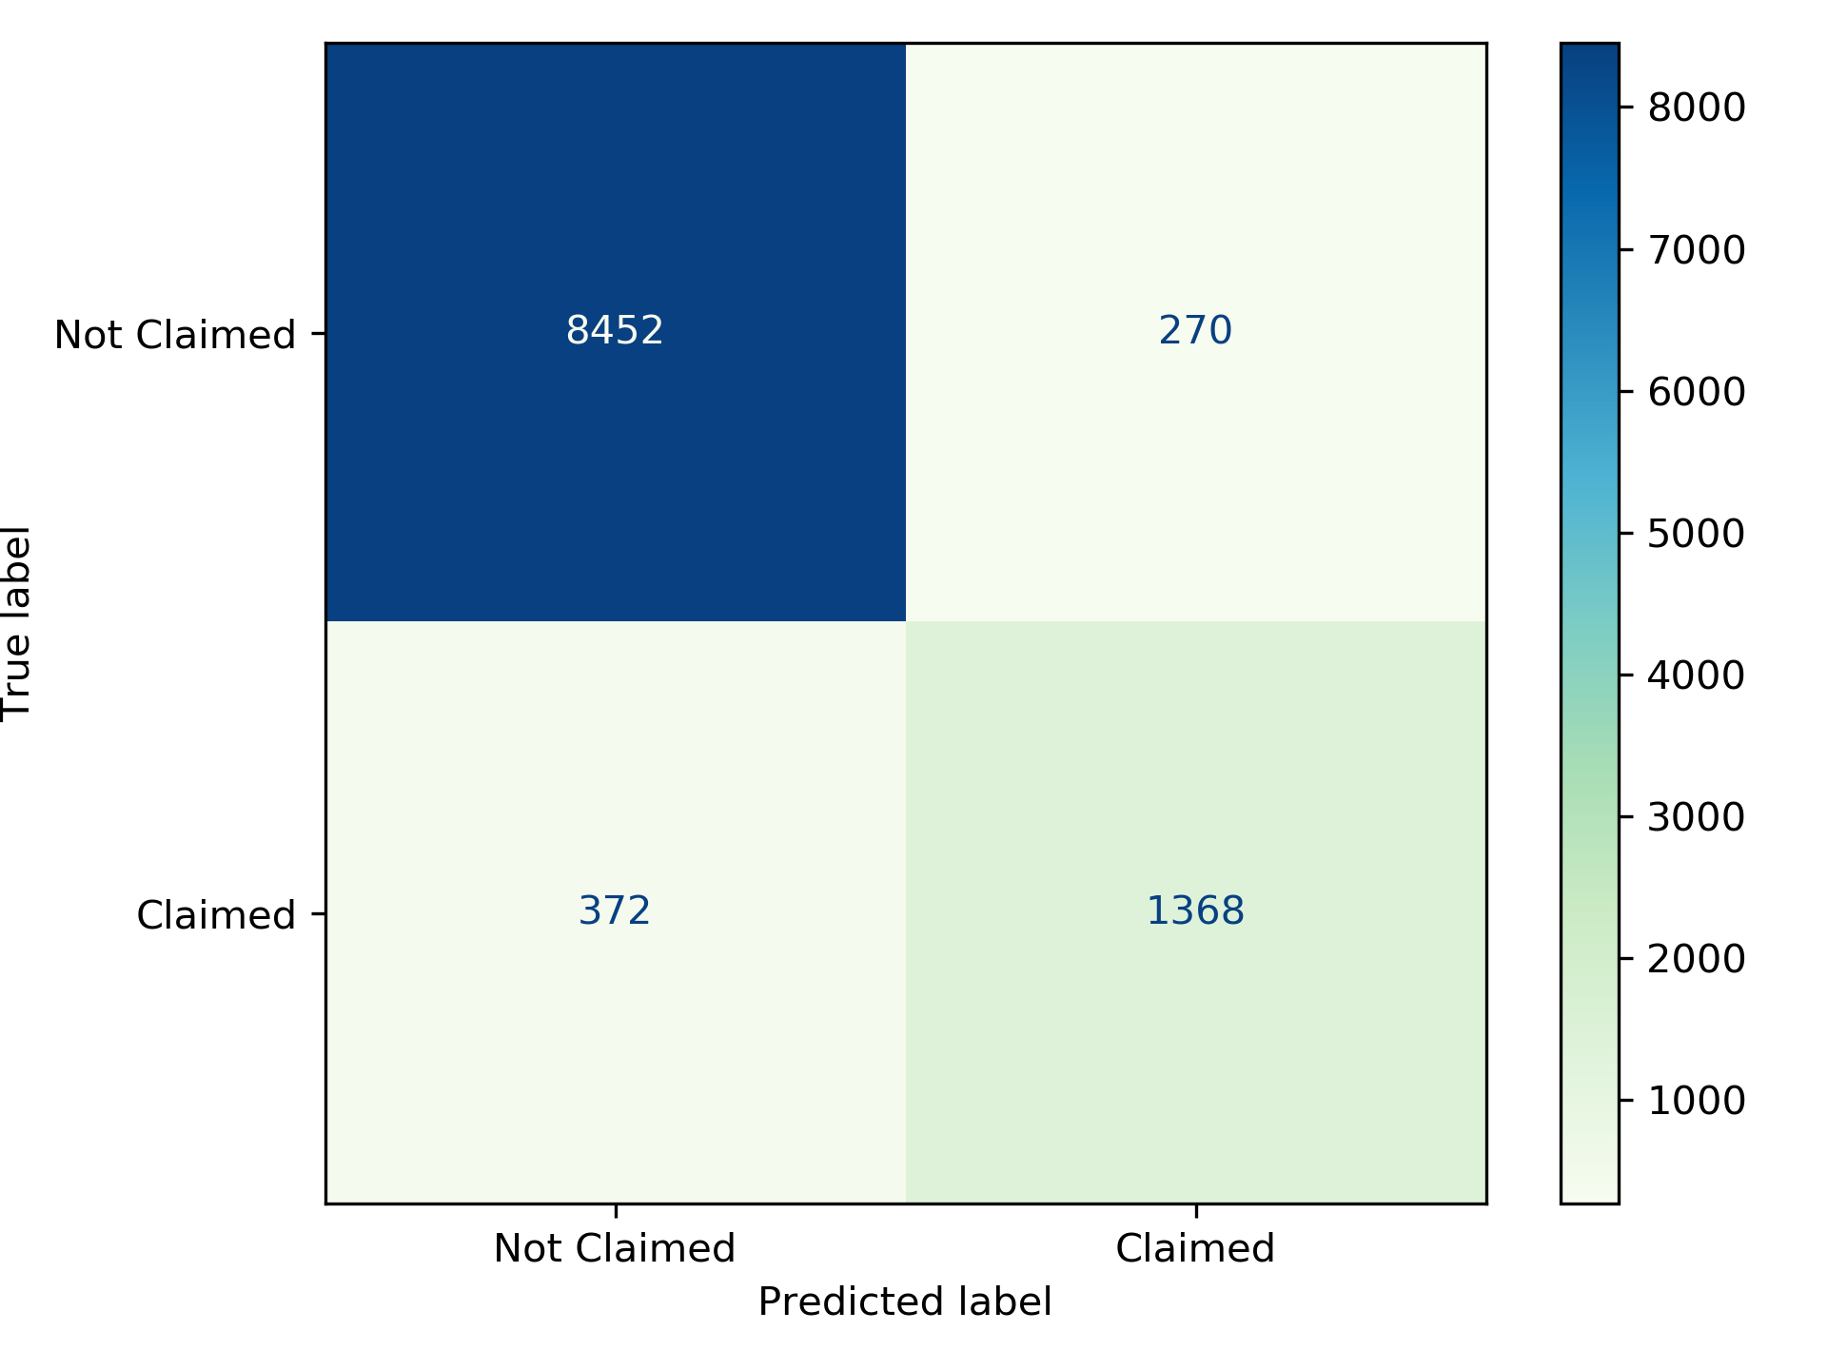
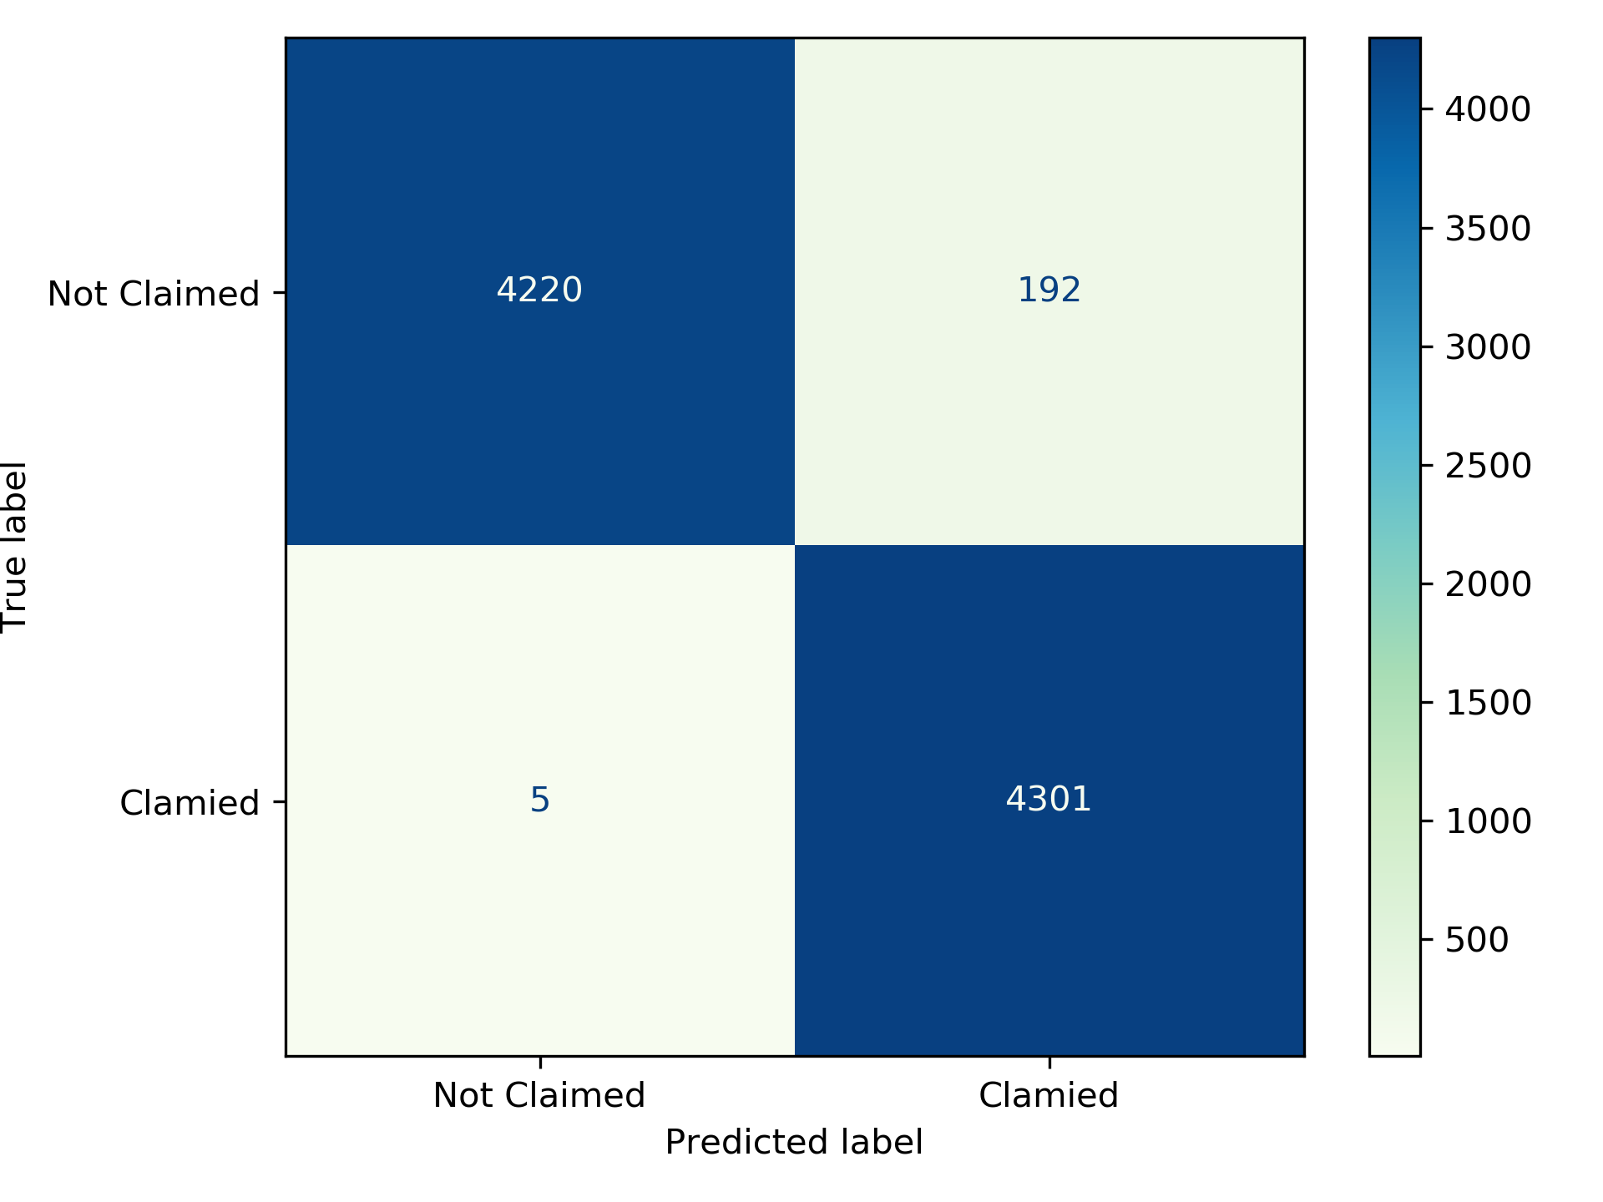
Confusion Matrix
Before OverSampling
After OverSampling

Slide 26
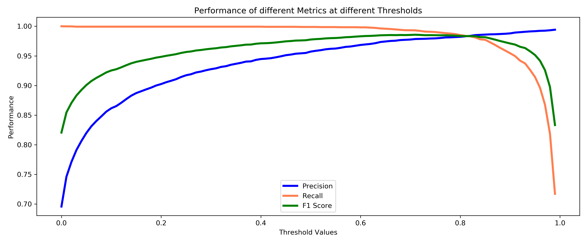

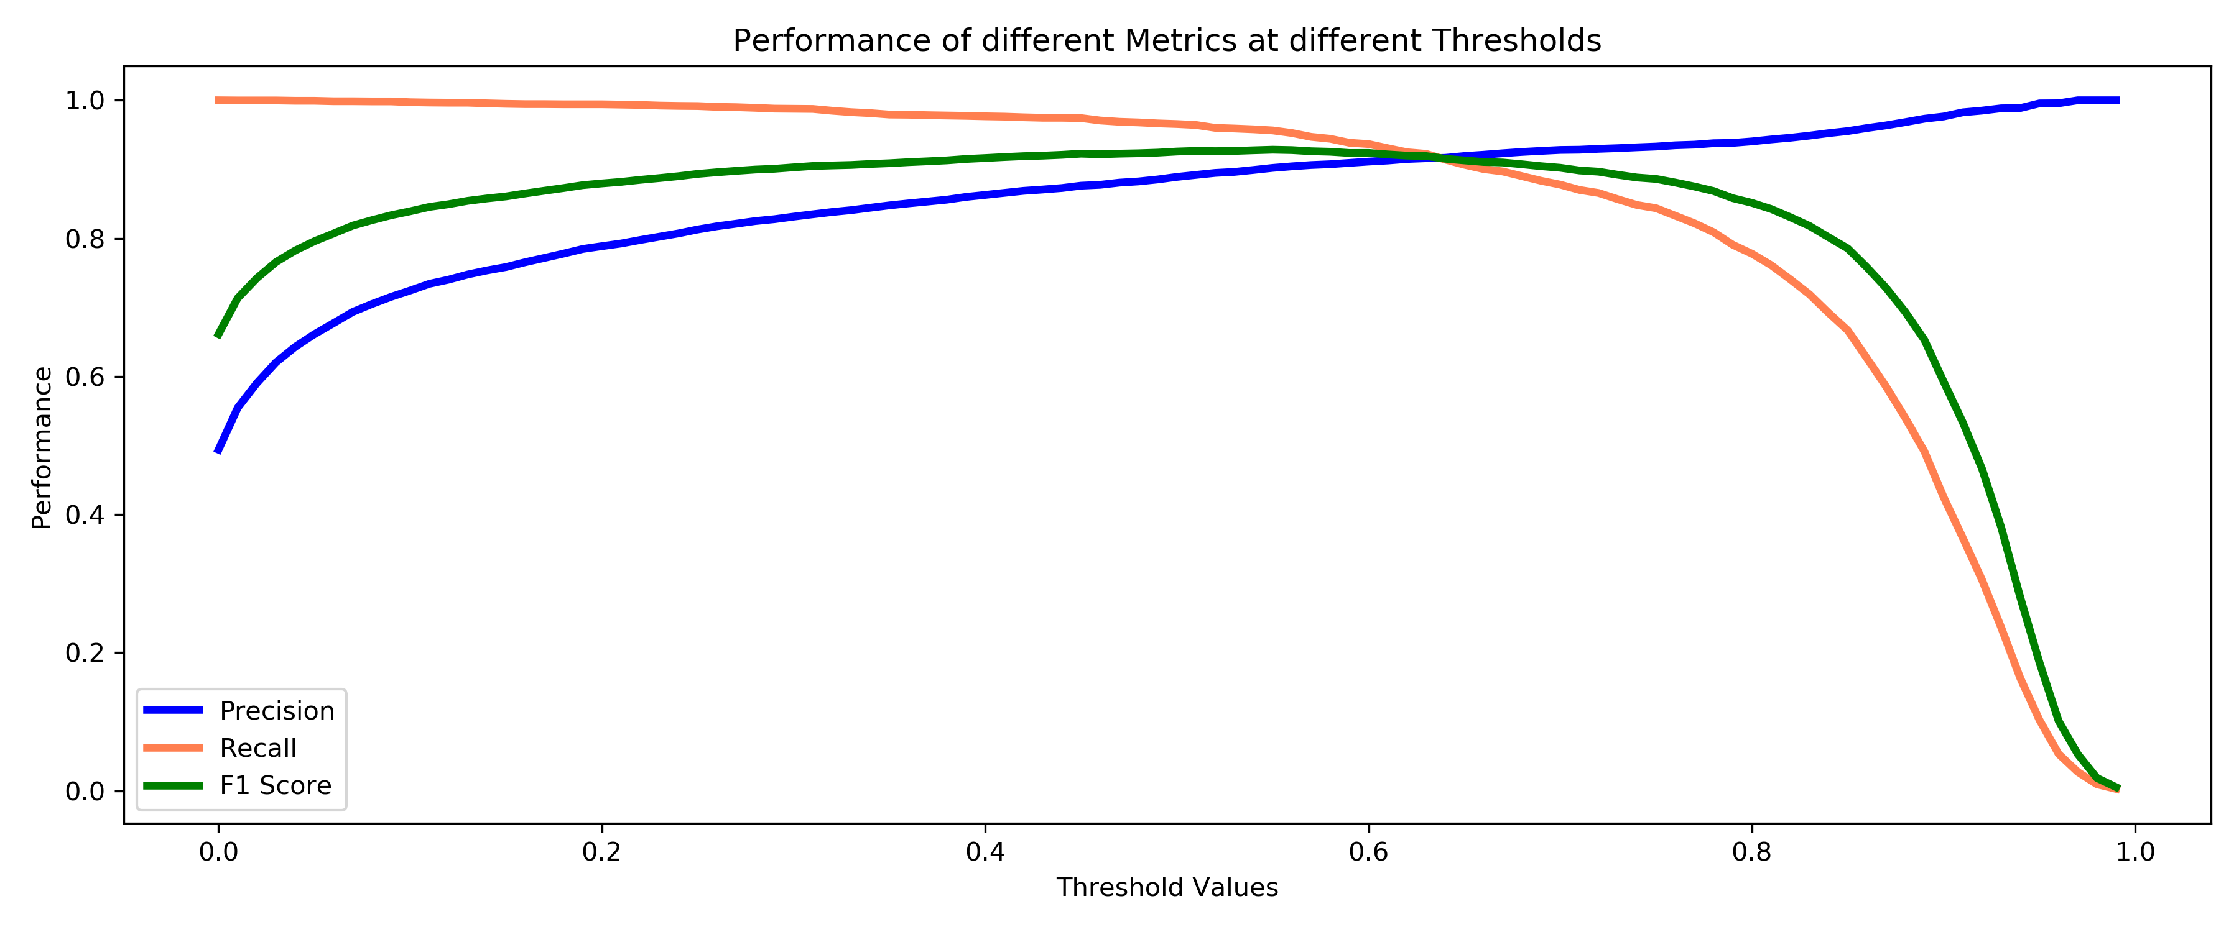
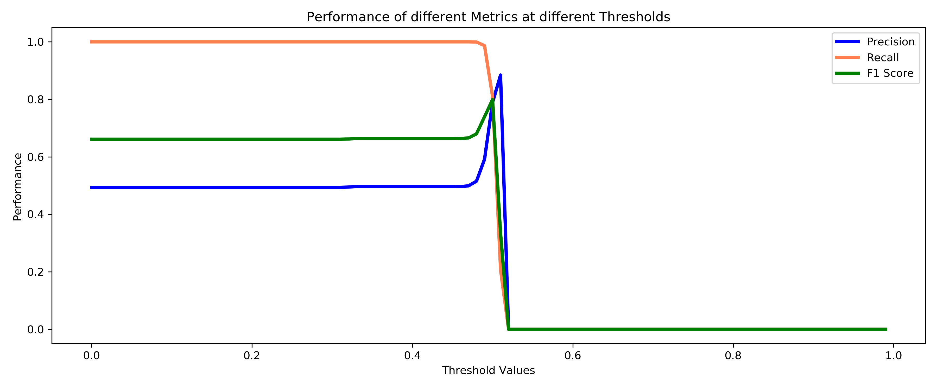
Random Forest Classifier
XGBoost Classifier
AdaBoost
Classifier

Slide 27
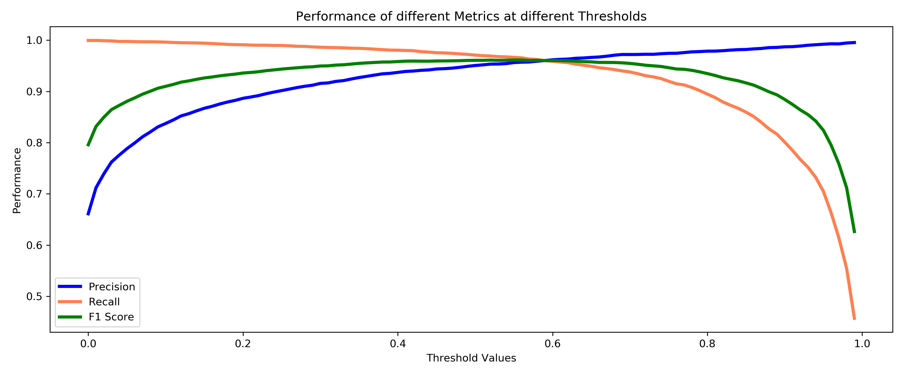
Random Forest Classifier (SMOTE)
Random Forest Classifier (OverSampling)
SMOTE is computational heavy and less stable over thresholds.
SMOTE gives higher precision of 0.96 on test data.

Slide 28

Presicion
(Train)
Precision
(Test)
Computation Time
Accuracy
Recall
F1 Score
1
Strategy
Before Oversampling
93.86
78.62
80.99
83.51
84.21
12.07 sec
After Oversampling (threshold = 0.98)
90.75
81.89
89.74
99.32
93.73
17.82 sec
11
Strategy
Before Oversampling
93.1
77.52
78.86
80.24
84.1
5.4 sec
After Oversampling (threshold = 0.98)
90.26
80.86
89.13
99.28
93.35
12,1 sec

Slide 29

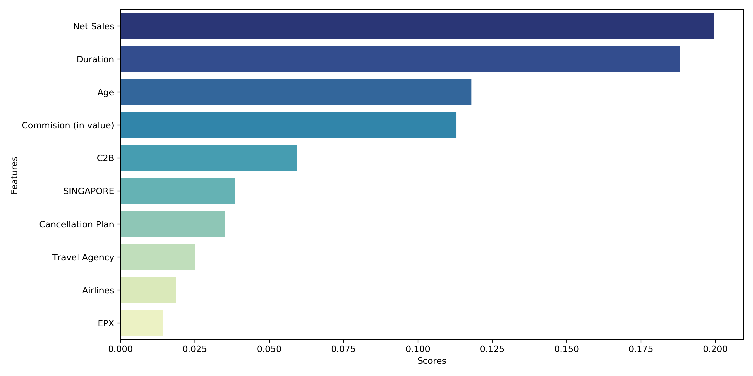
Feature Importance

Slide 30

Conclusion

Slide 31

Learnings
To make payments more affordable we need to have customers with low risk profile. Those will tends to claim less and hence the business can make more revenue/profit accordingly.
The risk to the insurance company increases based on the age of the customer. The claim ratio for the higher age group is 11%, so as to further reduce the risk to the insurance companies we need to cap the duration of insurance to 30 days instead of current average of 46 days.
As per the data customer trvalleing to Singapore, USA and South Africa have claimed the most. Thus the insurance company should charge the higher premium.
Low risk profile customers should be charged with a low premium of policy in order to ensure that we have more people buying up policies.
Further Data than would be beneficial: Purpose of travel and source country, Amount Claimed and Amount Sanctioned.
Further Data than would be beneficial: Customer profession, education, income.

Slide 32
Threshold Values
1
0.5
0.7
0.9
0.95
0.98
Computation Time
Strategy
Presicion
95.7
97.62
98.89
99.22
99.32
17.82 secs
Recall
99.88
99.3
95.63
91.68
81.79
F1 Score
97.74
98.45
97.23
95.3
89.7
11
Strategy
Presicion
95.21
97.38
98.86
99.18
99.28
12.1 secs
Recall
99.9
99.34
95.07
90.47
80.86
F1 Score
97.5
98.35
96.93
94.63
89.13

Slide 33





Wanderlust Data

